Slide 1
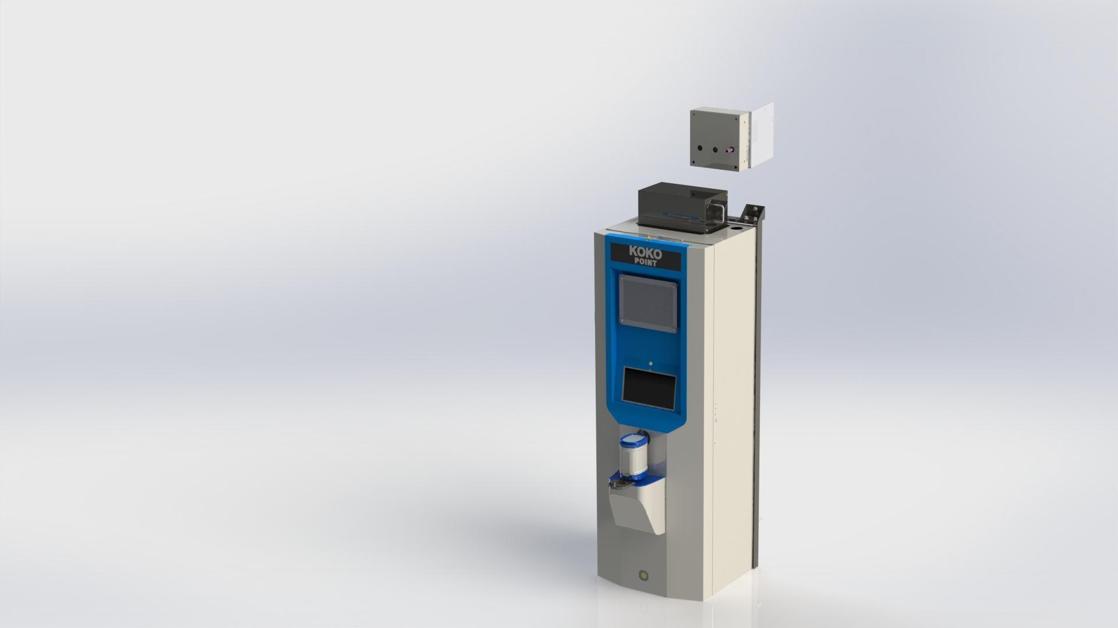
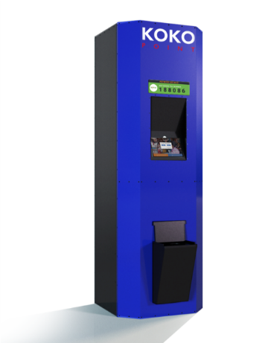
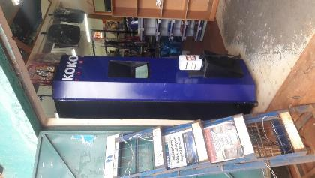
KOKOpoint dispenser design and functions
Notes:
Its OK

Slide 2
Background and objectives
Objectives
The purpose of this document is to enable trainees to understand a KOKOpoint basic functions
Parts List associated with assembly of Kokopoint(KP)

Slide 3
Contents
Areas to be covered
Operations (high level overview)
KOKOpoint Hardware
Software

Slide 4
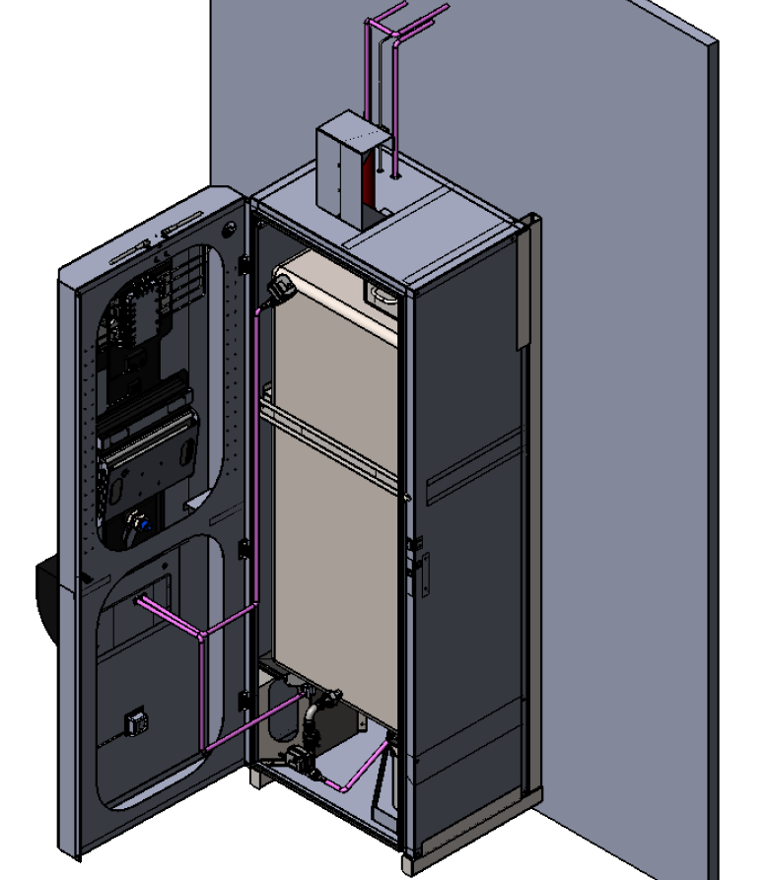
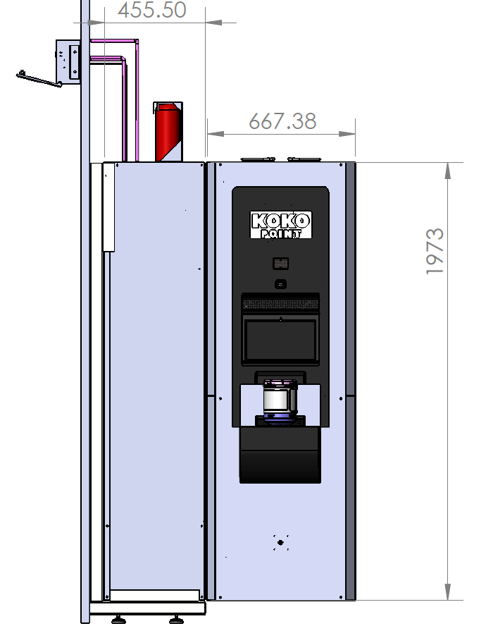
KOKOpoint overview
Refilling access box
UPS
Controller
SS Tank
User Interface
Canister dock
Flow meter

Slide 5
List of components
Tablet
Modem
Power Unit(UPS, Battery, Reset button,male and female 3 pin power plug)
KPC
Calibration PCB
Connector PCBs
Flowmeter
Motorised ball valves
Micro Pump
Dispense Valve (Solenoid)
NFC board
Tank level sensor
Canister full sensor
Door lock
Reed switch
PIR (motion sensor)
Smart Valve
Dock limit switch
Ethanol sensor
Temperature sensor
Pressure release valve
Mechanical fittings (manual ball valve,union,nipple,tee joint,tail end,elbow,cam lock, hose clip,reducing bush)

Slide 6
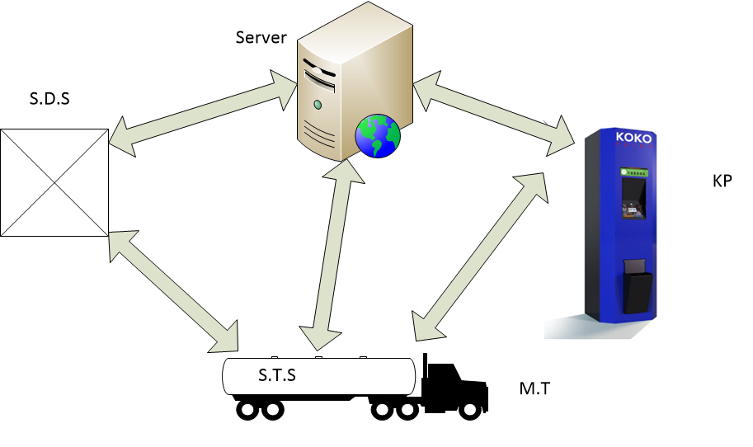
KP Communication Process
The KOKOpoint interacts with a number of KOKO platforms to aid in its operations as shown below

Slide 7
Dispense Process
When a customer docks a canister, NFC detects and reads the canister tag.
KP has an NFC reader that recognizes the canister’s chip.
Through the tablet the KP allows the customer to Log in to the system to buy fuel.
The tablet remotely communicate with the server (through the modem that provides connectivity) and request for a PIN from the customer.
Customer logs in and his/her Account and details are displayed.
Customer is able to buy fuel.
Customer logs out/exit and Undocks the canister.
Also a KOKO maintenance technician is able to perform various maintenance tasks

Slide 8
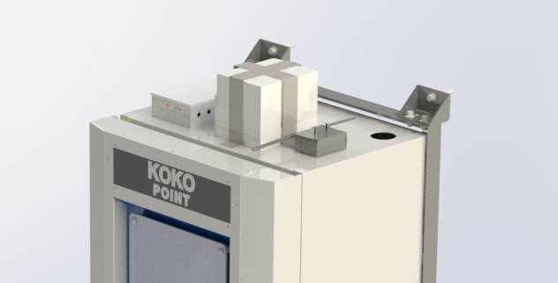
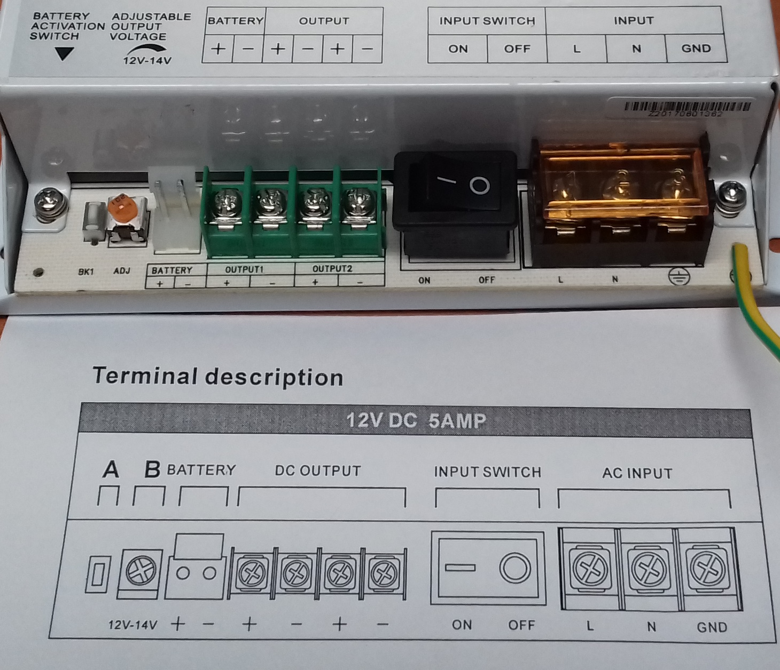
Contents
Power Unit
The power unit of the KP consists of UPS and a battery 12V, 40Ah .
The KP is powered by 240V AC mains which is converted to DC via a UPS that supplies the KPC with 12VDC
UPS have the capability of running for 10 hrs average on battery during power outage.
AC
DC
UPS
Charging
Back Up
12V Battery

Slide 9
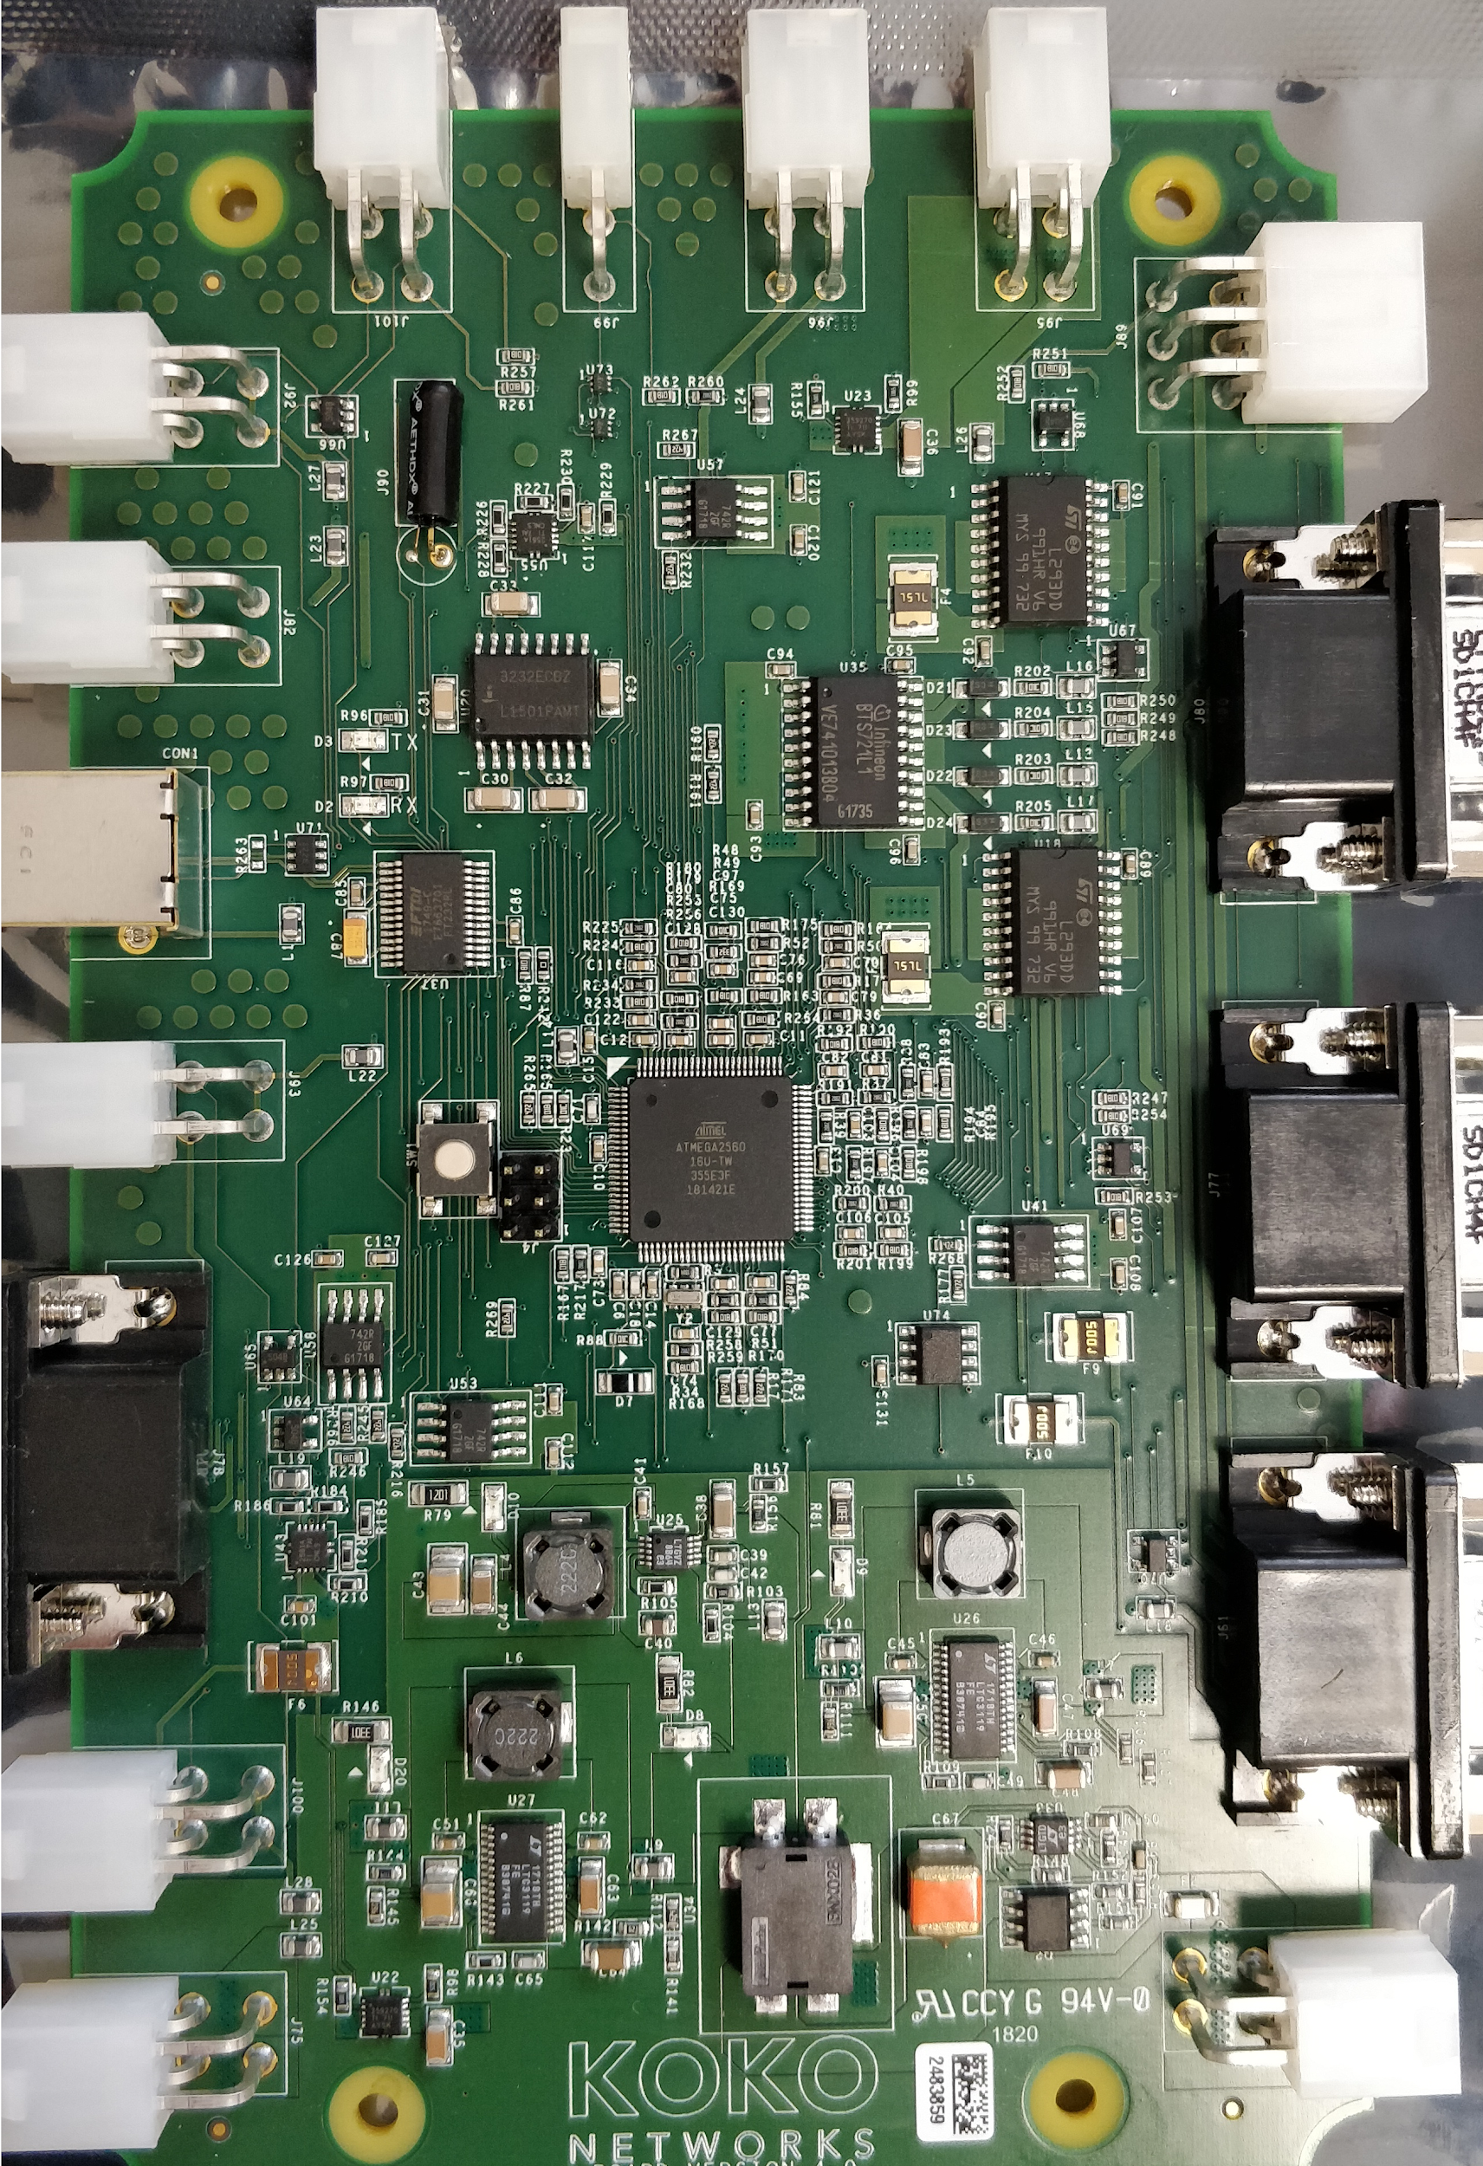
KPC
KOKOpoint Controller
Custom designed and built PCB controller.
This is the heart of the KOKOpoint
The firmware is uploaded to to the embedded arduino board(Atmel) to control the system when commands are issued

Slide 10

Tablet
This is an android device customized for use by the KP.
An android application KOKO apk is installed to allow the customer to access his/her account, order a stove and fuel purchase (through a canister with an NFC tag).
A KOKO launcher apk is installed to launch the KOKO app

Slide 11
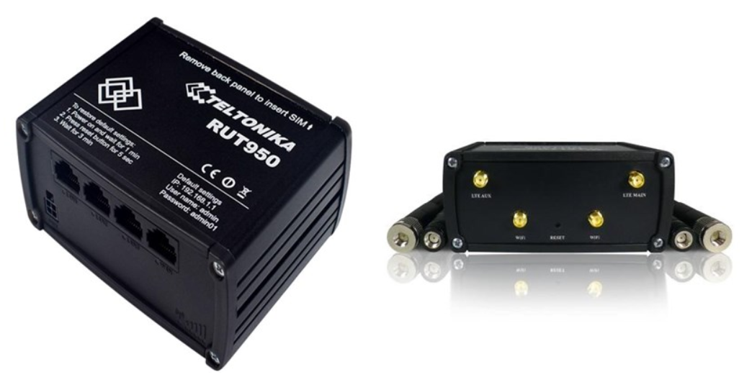
Modem
Teltonika modem - RUT9XX
The modem enables remote communication from the KP agent location to NOC.
It uses mobile network service providers, our modem abides to telecommunication regulations
Service Providers: Safaricom (main service provider)
and another backup service provider.
It has two antennae.
Also has power cable and an ethernet cable.

Slide 12
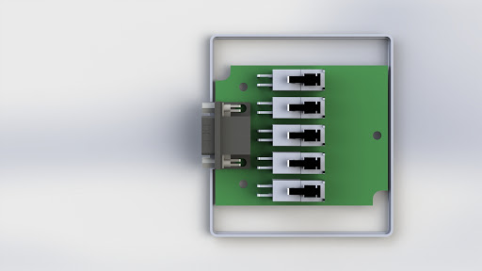
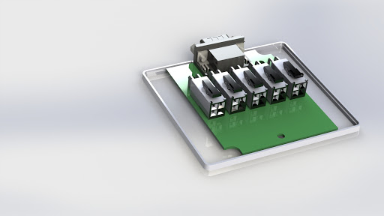
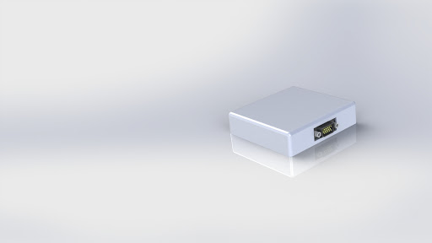
Connector PCB
Lead seal applied here
FLM
DV
TS
IE
TEMP
KOKOpoint connector PCB box for various components.
There are five PCB connectors above tank, below left, below right, refill box and power unit PCBs
The one shown in the picture above is below left
They connect the KPC to various components

Slide 13
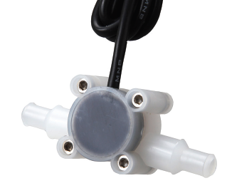
Flowmeter
The turbine flowmeter is the measuring unit of the KOKOpoint
At the heart of the turbine flow meter is a precision turbine that rotates freely on robust sapphire bearings and contains over-moulded magnets that are detected through the chamber wall by a Hall effect detector. The output is a stream of NPN/PNP pulses that are readily interfaced with most electronic display or recording devices.
The number of pulses is then what is converted into volume
Has a flow direction as demonstrated

Slide 14
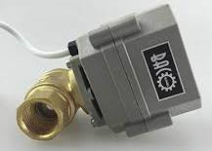
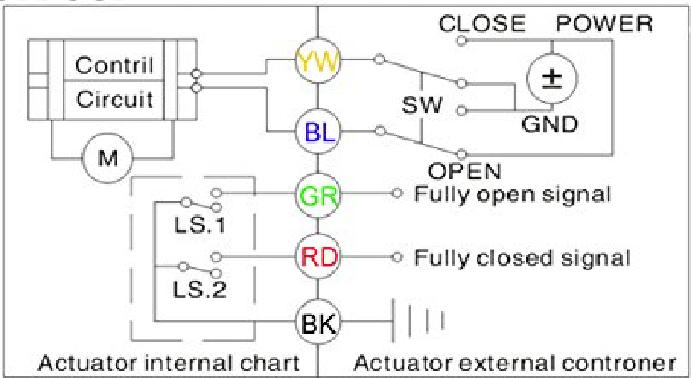
MBV
It is a motor driven actuator to open and close a valve.
The valve opens to allow fuel flow during dispense.
It uses two limit switches to indicate valve positions.

Slide 15
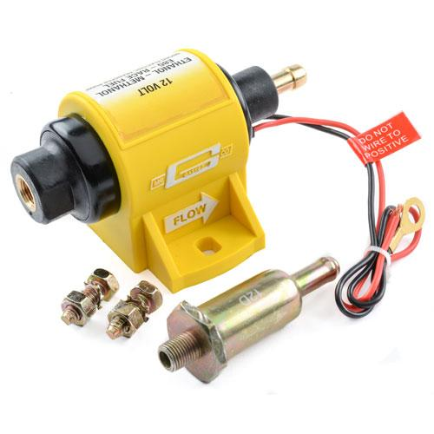
Contents
Micro Pump
This is an inline pump that provides a constant flow rate during dispensing
It is directional

Slide 16
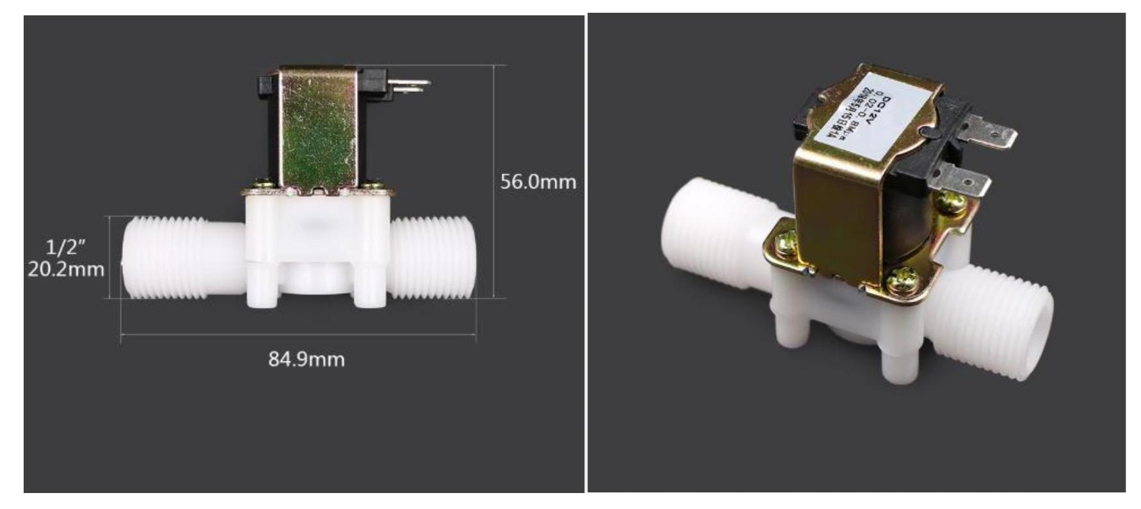
Contents
Diaphragm Valve, DV (Solenoid)
This a normally open valve used for dispense precision during dispensing
It is one way valve(directional).

Slide 17
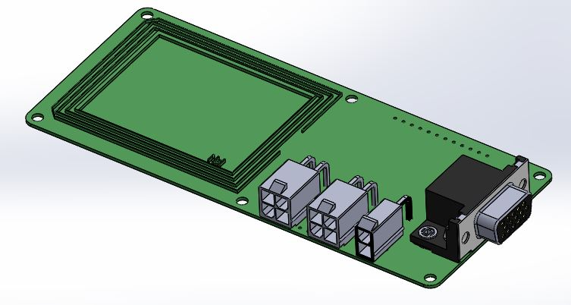
Contents
NFC PCB
Near field communication is the communication link between a canister and the KP

Slide 18
Tank Sensor
Level sensor indicates level of fuel in the tank
It is an analogue pressure sensor

Slide 19
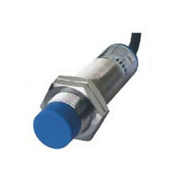
Canister Full Sensor
It is a capacitive sensor that prevents a canister from overfilling

Slide 20
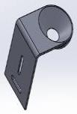
Door lock
The KP uses an electro-mechanical lock that enables both remote access to the KP or mechanically using keys

Slide 21
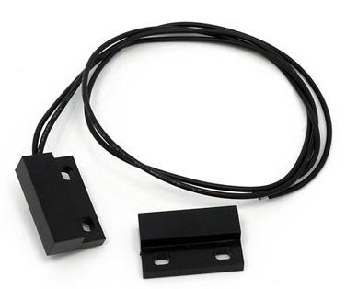
Reed Switch
It is an electromagnetic switch that used to indicate when a KP door is opened or closed

Slide 22
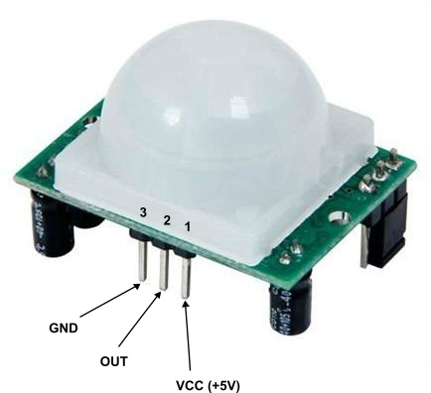
PIR Module
PIR- based motion detector
A passive infrared (PIR) sensor is an electronic sensor that measures infrared light radiating from objects in its field of view

Slide 23
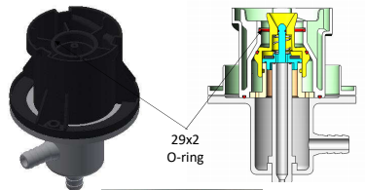
Smart Valve
This a custom made valve designed by KOKO
This is where a canister is docked to enable a customer to purchase fuel
Consists of a number of o-rings

Slide 24
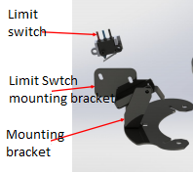
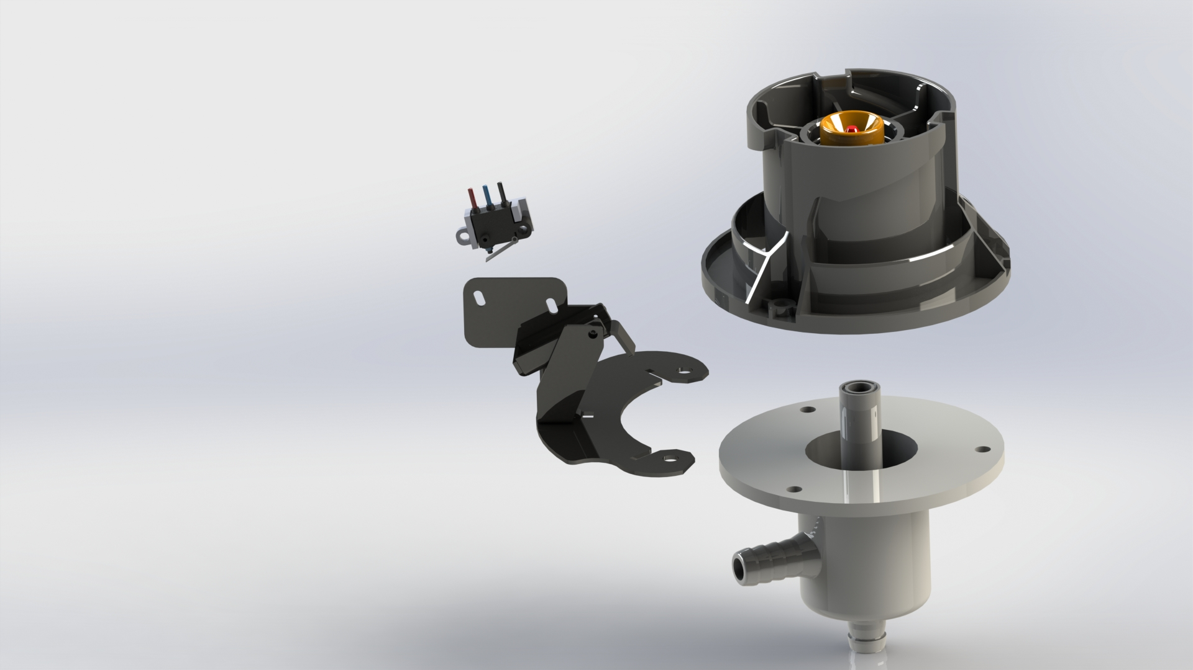
Dock Switch
The limit switch informs when a canister is docked and undocked

Slide 25
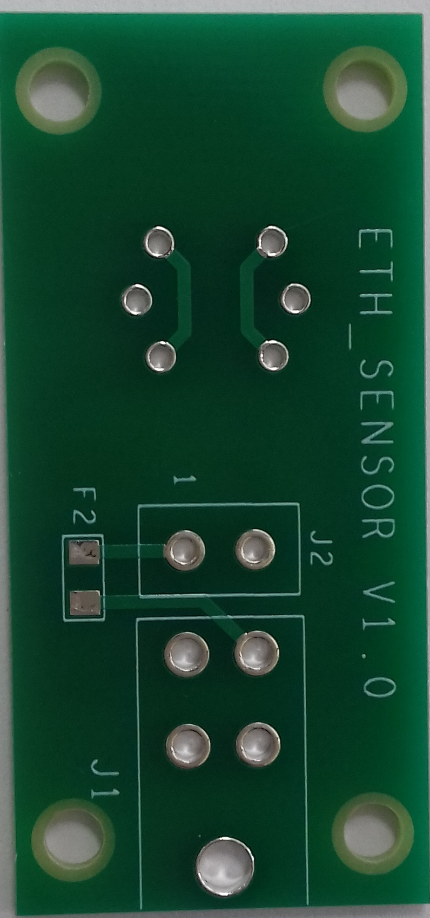
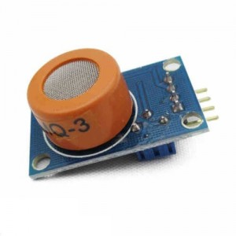
Ethanol Sensor
The ethanol sensor (MQ3) is used to detect ethanol concentration in the KP.
This informs when a KP is leaking

Slide 26
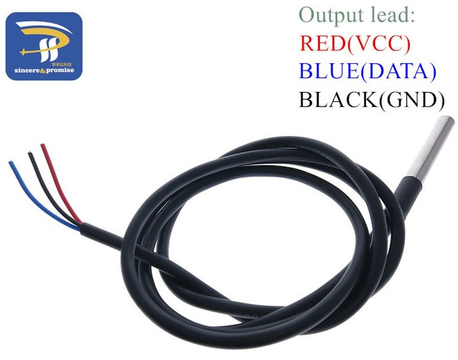
Temperature Sensors
We have two Temperature sensor; - Internal Temperature sensor is located under the tank - External Temperature sensor is stuck on the tank
Function
Internal Temperature sensor is used to monitor internal KP temperatures
External Temperature sensor is used to monitor fuel temperatures of the tank.

Slide 27
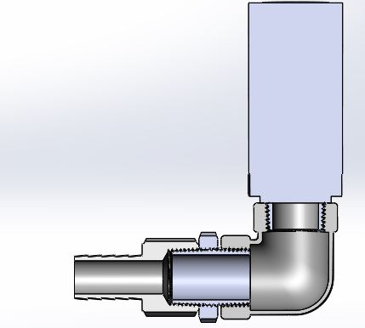
Pressure Release Valve, PRV
Is a safety valve that controls ethanol vapour to a certain threshold

Slide 28
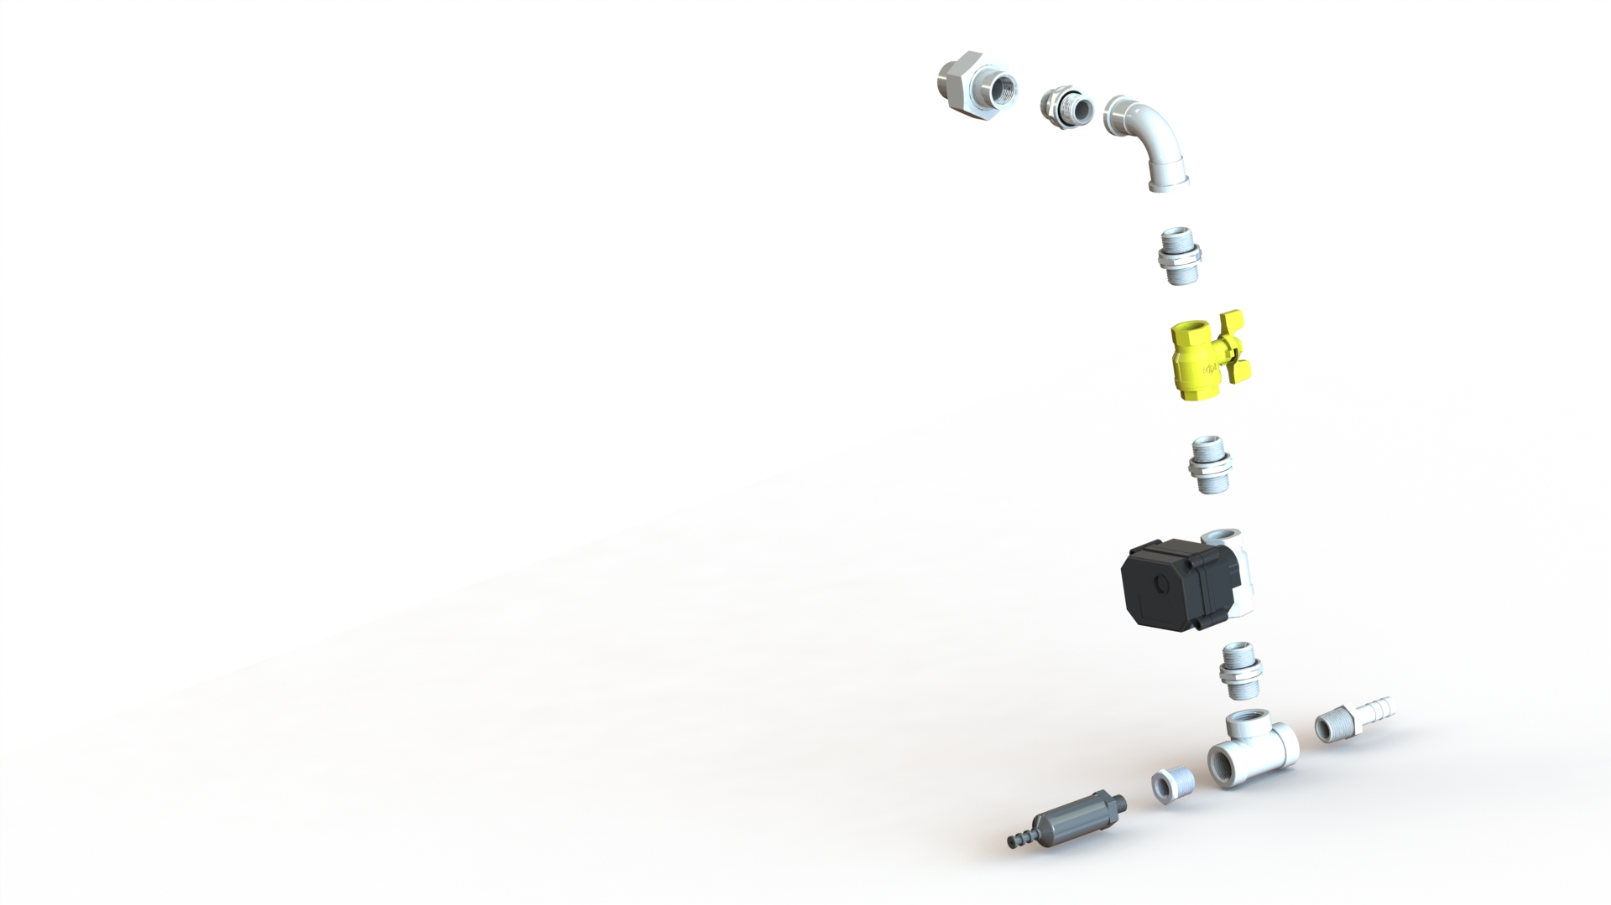
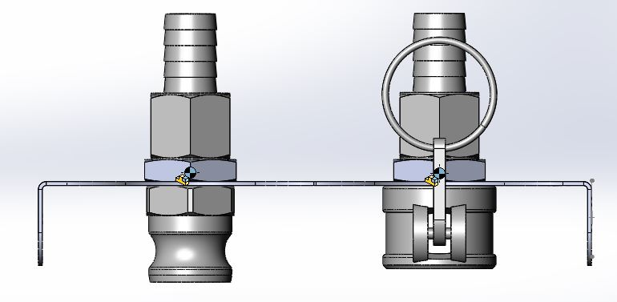
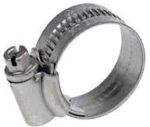
Plumbing Fittings
The KP has various SS mechanical fittings as shown below (right picture)
The union main purpose is to position the dispense column in place
Manual ball valve is used to separate the tank and during maintenance of faulty components
The refill box consists of cam locks as shown (left picture) one for refill fuel and refill air
Silicone hose is also used to join various barbed connectors(tail end) clamped using a hose clip(centre)
Union
Elbow
Nipple
Manual Ball Valve
Tail End
Tee Joint
Reducer

Slide 29
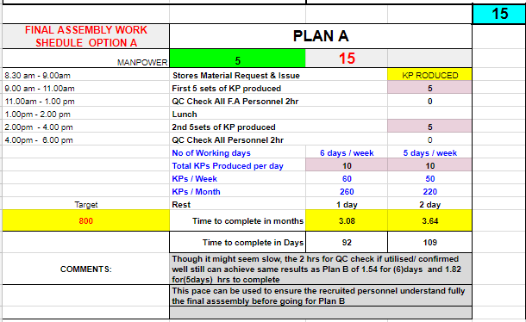
KP FINAL ASSEMBLY SCHEDULE

Slide 30
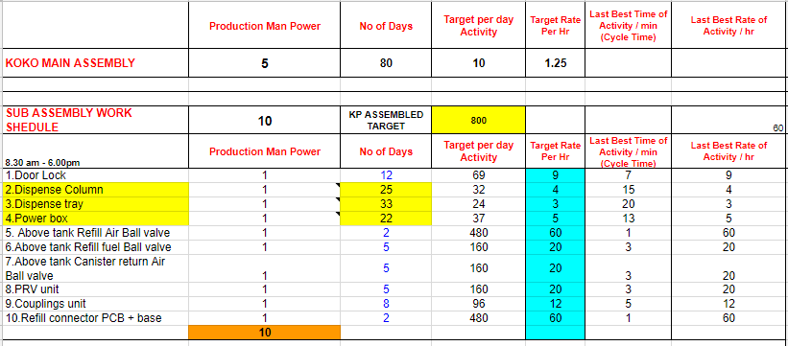
KP MAIN ASSEMBLY AND SUBASSEMBY

Slide 31
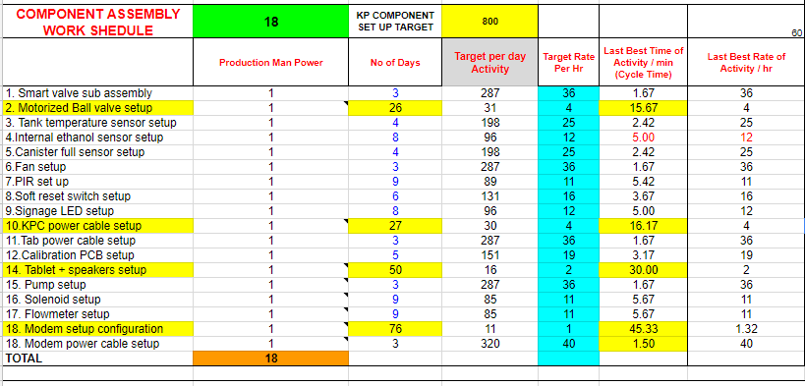
KP COMPONENT ASSEMBLY

